Slide 1
Presentation on Structures Of Operating System
Presented by: Dipesh tha Shrestha dipesh khadgi
Presented To: KUSHAL REGMI

Slide 2
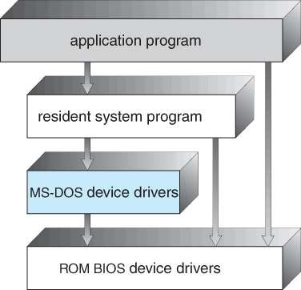
Simple Structure
Simple Structure
In MS-DOS, the interfaces and levels of functionality are not well separated.
Application programs are able to access the basic I/O routines to write directly to the display and disk drives.
Such freedom leaves MS-DOS vulnerable to errant ( or malicious) programs, causing entire system crash when user program fails.
This structure is:
not-well protected
not-well structured
not- well defined

Slide 3
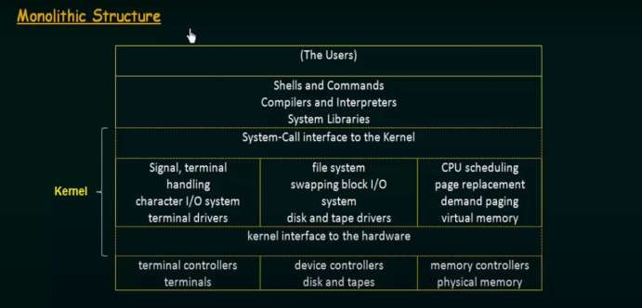
Monolithic Structure
Too many functions packed into one level
Implementation and maintenance is difficult.
Have to play with the entire kernel to make changes for addition or removal of features.

Slide 4
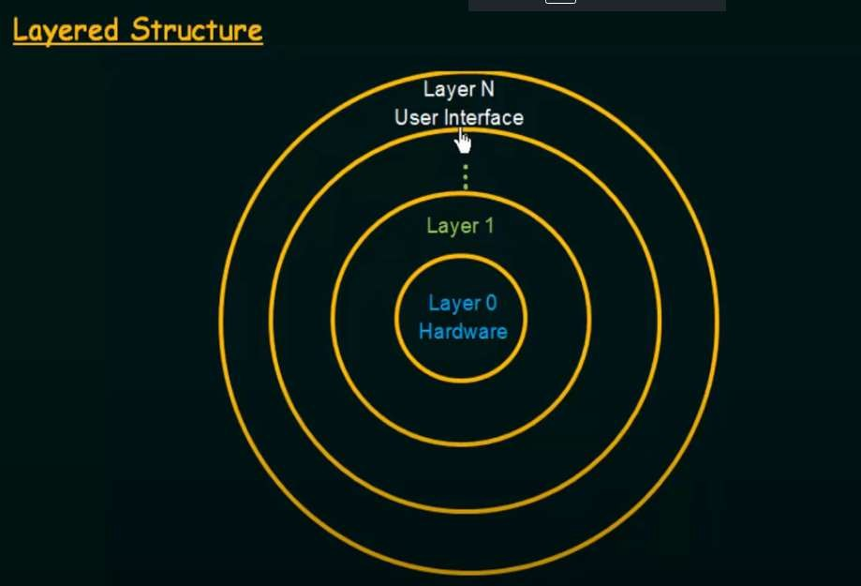
Layered Structure
Layered Structure
All the layers can be defined separately and interact with each other as required. Also, it is easier to create, maintain, and update the system if it is done in the form of layers.
Change in one-layer specification does not affect the rest of the layers.
Each of the layers in the operating system can only interact with the layers that are above and below it.
The lowest layer handles the hardware and the uppermost layer deals with user applications.

Slide 5
MicroKernel
A kernel is an important part of an OS that manages system resources.
A microkernel is a software or code which contains the required minimum amount of functions, data, and features to implement an operating system.
In Monolithic Kernel approach, the entire operating system runs as a single program in kernel mode
A Microkernel is the most important part for correct implementation of an operating system.

Slide 6
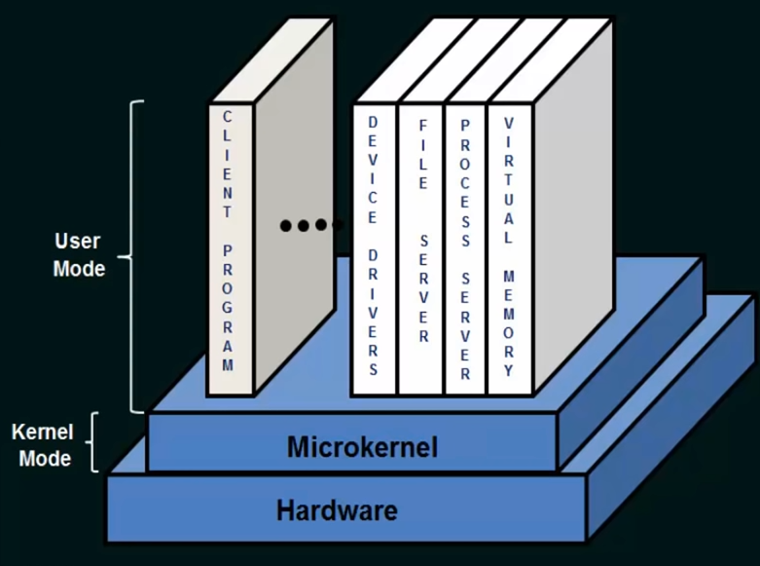
Microkernel

Slide 7
Advantages of Microkernel –
The architecture of this kernel is small and isolated hence it can function better.
Expansion of the system is easier, it is simply added in the system application without disturbing the kernel.
Microkernels are secure because only those components are included that disrupt the functionality of the system otherwise.
Microkernel interface helps you to enforce a more modular system structure.

Slide 8
Disadvantage of Microkernel
Providing services in a microkernel system are expensive compared to the normal monolithic system.
Context switch or a function call needed when the drivers are implemented as procedures or processes, respectively.
The performance of a microkernel system can be indifferent and may lead to some problems.

Slide 9
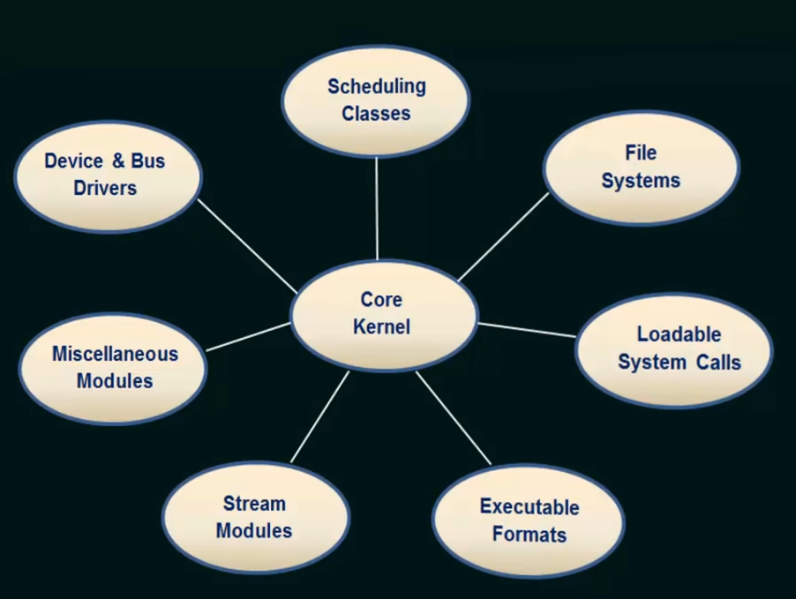
Modules Architecture

Slide 10
Modules
The best current methodology for operating-system design involves using loadable kernel modules
The kernel has a set of core components and links in additional services via modules, either at boot time or during run time.
The kernel to provide core service while other services are implemented dynamically, as the kernel is running.
More flexible than a layered system, because any module can call any other module.
More efficient than a microkernel, because modules do not need to invoke message passing in order to communicate.

Slide 11
modules
The loadable kernel modules in an operating System is an object file that contains code to extend the running kernel, which is also know as the base kernel.
The loadable kernel modules are used to add the support the files systems, hardware, system calls etc.
Her, the kernel has a set of core components and links in additional services via modules, either at boot time or during run time.
The idea of the design is for the kernel to provide core services while other services are implemented dynamically, as the kernel is running.

Slide 12
Thank YOu

